Slide 1

ECARE
Your Ultimate Destination for Healthcare Solutions
Presented by: Pradeep Chaudhary
Prabin Yadav
Rahul Kumar Yadav
27 July, 2024

Slide 2

INTRODUCTION
GREETING FROM US
The "Ecare" Hospital Management System is a web-based application designed to streamline and enhance various hospital administrative and clinical processes.
This system aims to
improve patient registration and record
management, automate appointment scheduling, and facilitate efficient billing and payments.
It optimizes resource and inventory management and enables better communication among healthcare providers.
This system is
designed to increase patient engagement and
satisfaction providing a comprehensive solution to modernize hospital operations and improve overall healthcare facilities.

Slide 3

PROBLEMS
01
Lack of Real-Time Reporting
02
Inefficient Appointment Scheduling
03
Manual Patient Registration and Management
04
Limited Access to Medical Records

Slide 4


SOLUTIONS
WE WILL SOLVE THE PROBLEMS
01
Lack of Real-Time Reporting
Implement real-time reporting tools to provide up-to date
information for management.
02
Inefficient Appointment Scheduling
Develop an online appointment scheduling system that allows easy booking, rescheduling, and cancellation of appointments.
Manual Patient Registration and Management Implement an automated system for patient registration and management, ensuring accurate and efficient handling of patient information.
03
04
Limited Access to Medical Records
Provide a centralized, digital repository for medical records that is accessible to authorized users anytime, anywhere.
05
Poor Communication Among Healthcare Providers
Integrate communication tools within the system to facilitate
secure and efficient communication among healthcare providers.
ECARE

Slide 5


To make online appointment between doctors and patients & check their appointment status.
OBJECTIVES
01
To pay the doctor’s consultant fee online
02
to save their time.
To make view on lab test, lab report & prescriptions online through panel.
03
To ensure accurate and up-to-date patient and doctor information is readily accessible to authorized personnel, facilitating better decision- making and patient care.
04
ECARE

Slide 6


HOW WE WORK?
01
Create,update and delete user account
02
Edit Doctors details
As a Admin
Generate and manage invoices for patient services.
03
04
Access patient records and doctor records
05
Add pharmaceutical and generate payroll

Slide 7

HOW WE WORK?
Register as a new patient and create a personal profile
Update personal information and medical history
Book, reschedule, or cancel appointments with doctors.
01
02
As a Patient
03
04
Make Payment through khalti & View invoices for
services received
05
View lab result and prescription

Slide 8

HOW WE WORK?
View and manage daily schedules and appointments.
01
02
Confirm or cancel appointments as needed
As a Doctor
03
Access and update patient medical records
Order lab tests and view results directly within the system
04
Access patient care reports and treatment
05
outcomes.

Slide 9
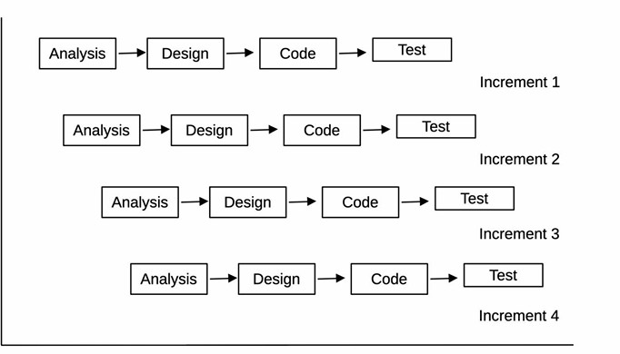
INCREMENTAL MODEL

Slide 10
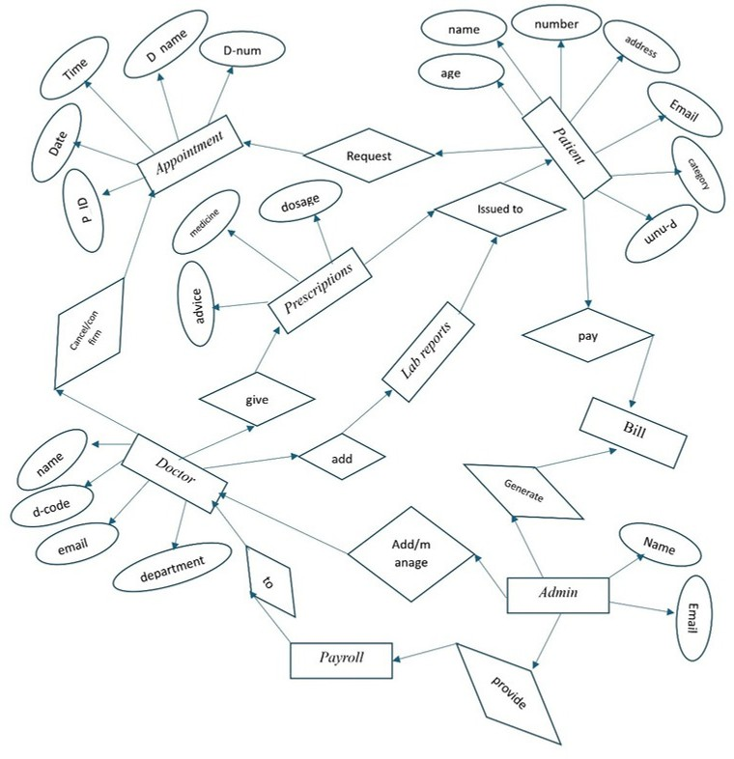
ENTITY RELATIONSHIP DIAGRAM

Slide 11
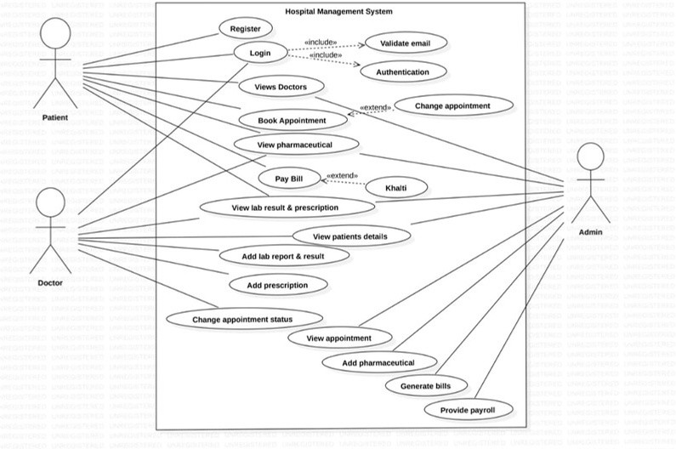
USE CASE

Slide 12
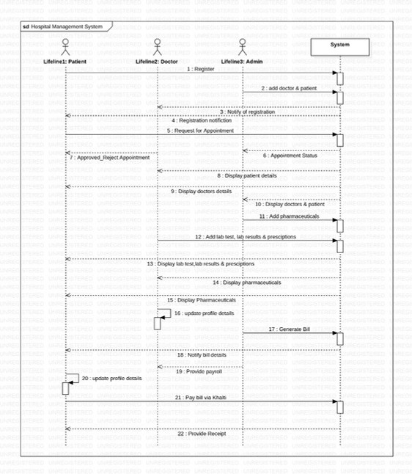
SEQUENCE DIAGRAM

Slide 13
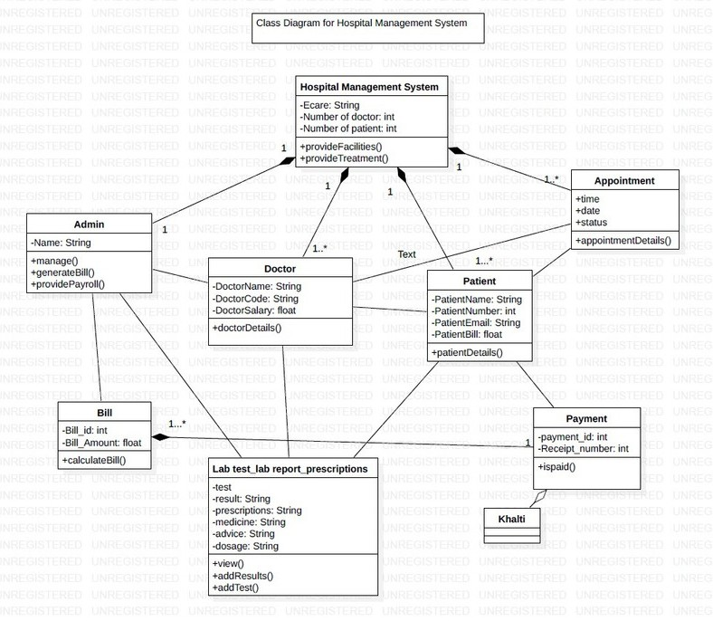
CLASS DIAGRAM

Slide 14
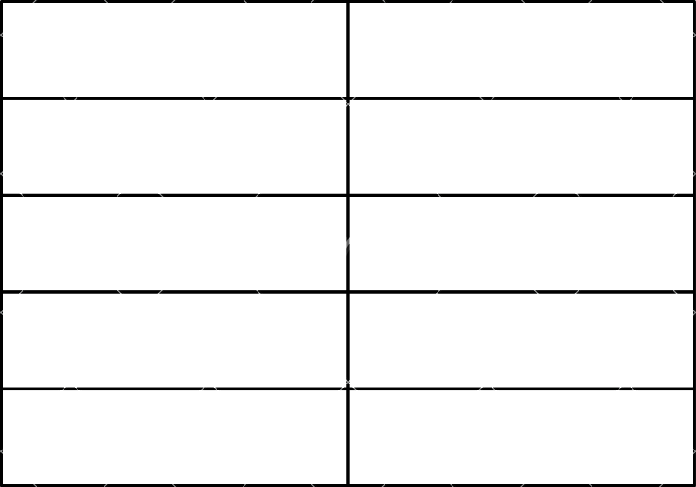
TOOLS AND TECHNOLOGY
Tools
Used in
HTML,CSS ,JS & Bootstrap
Used in frontend.
PHP
Used in backend.
MYSQL
Used to connect and store database.
Microsoft Word
Used for documentations.

Slide 15
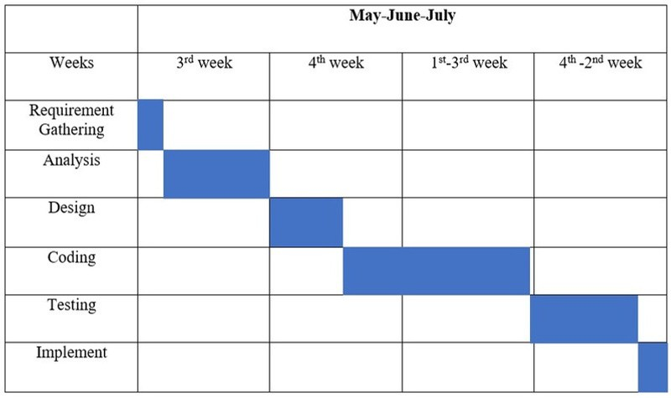
PROJECT TASK AND TIME SCHEDULE

Slide 16

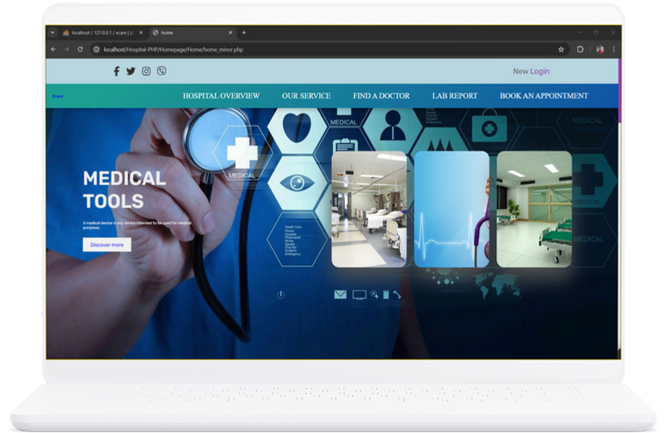
TASK DONE
ECARE

Slide 17

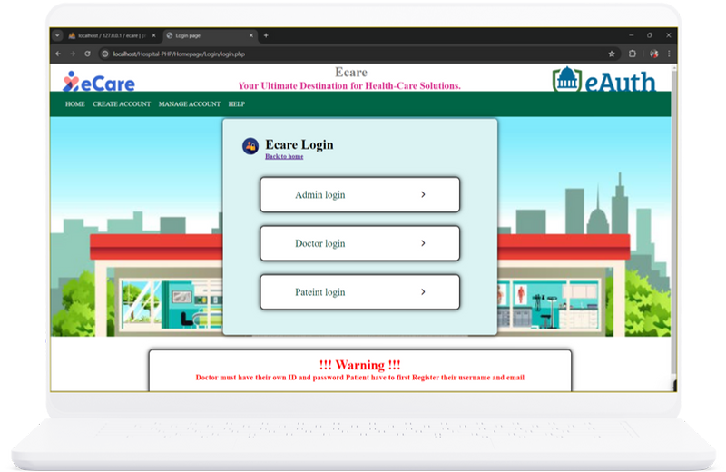

Slide 18

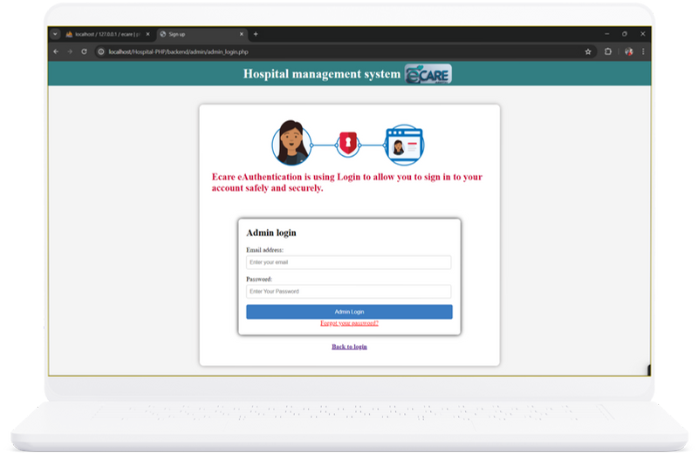
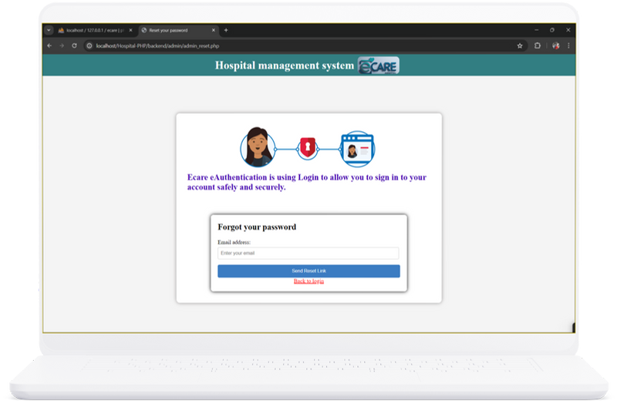

Slide 19


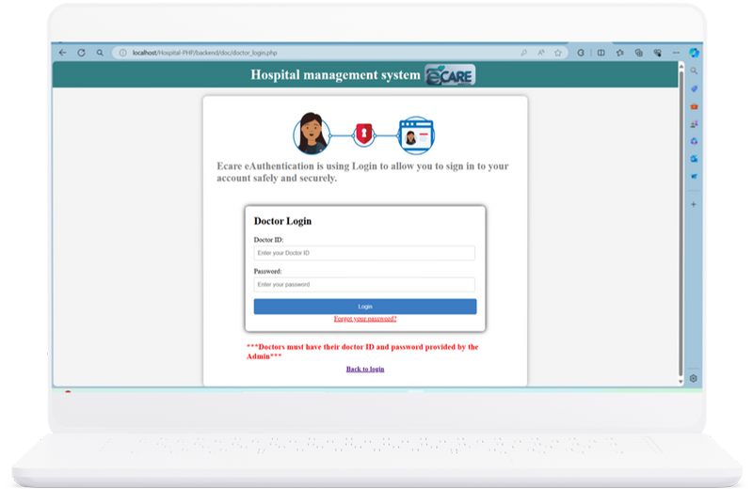
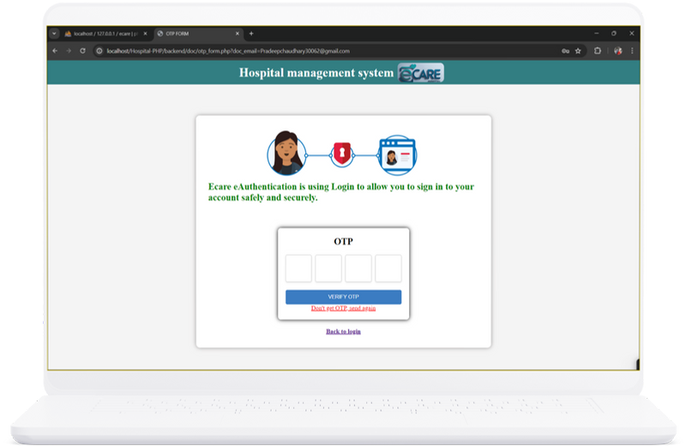

Slide 20


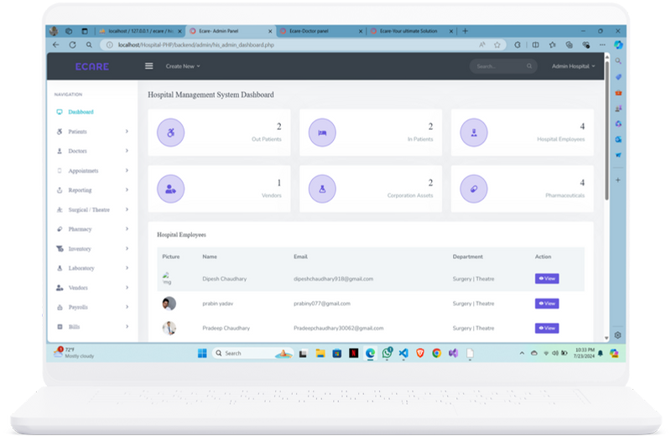
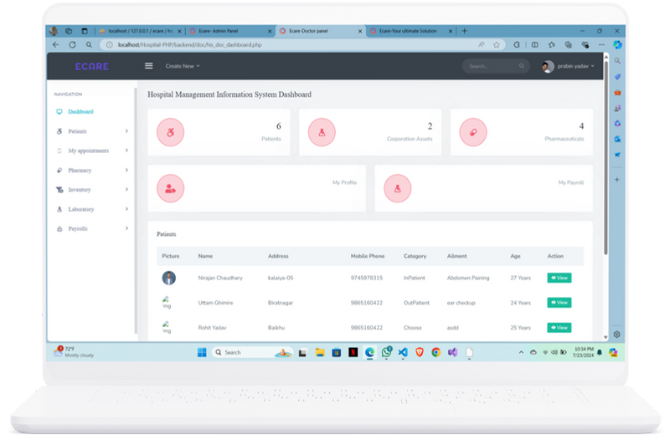

Slide 21


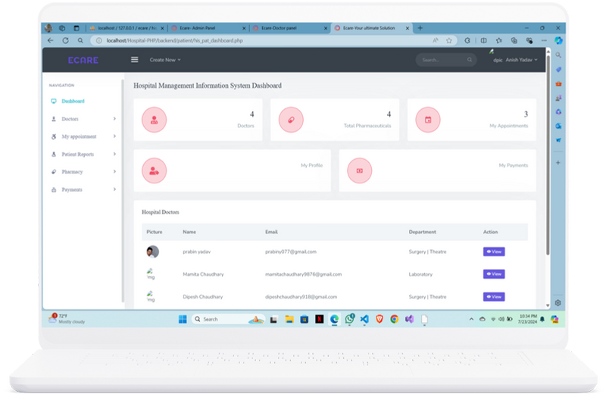
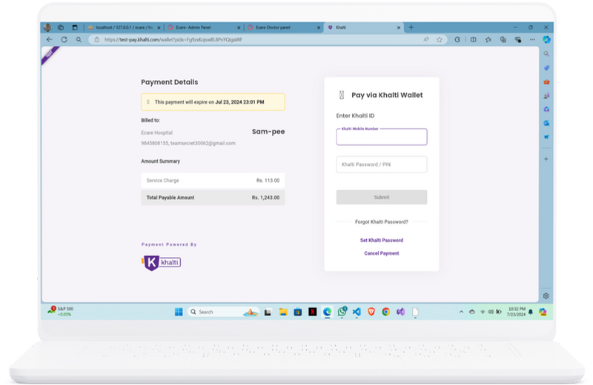

Slide 22


PROJECT OUTPUT
ECARE
User Interface and Design
Booking Appointment
User Registration and Login
Verification through OTP
Admin Dashboard
Doctor Dashboard Patient Dashboard Responsive Design Payment Integration

Slide 23







Team Members
Pradeep Chaudhary
Prabin Yadav
Rahul Yadav

Slide 24

THANK YOU
FOR YOUR NICE ATTENTION
27 July, 2024

